Slide 1
EDA Group Case Study
By,
Srivalli Pavana Gayathri Hari,
Priti Pratikshya Pradhan

Slide 2
Problem Statement
Loan providing companies keep a track of the credit history of their customers to know if their record in the past is clear or not.
In the absence of a credit store for a customer, it becomes hard for the companies to give loans due to insufficient information about the customer.
Because of the lack of such information, customers might take advantage of the company and become defaulters.
When a company receives a loan application, the company has to decide for the loan approval based on the applicant’s profile. There are two kinds of risks involved with the bank’s decision:
If the applicant is likely to repay the loan, the rejecting the application may result in a loss to the business to the company.
If the applicant is likely to be a defaulter, then approving the application may result in a financial loss to the company.

Slide 3
Business Objective
The objective of this case study is to identify patterns from the past data that indicate if a customer has difficulties in repayments which may be sued to take actions such as rejecting, approving or investigating a loan application.
The analysis will be aimed at identifying the driving factors behind loan defaults, so that the company can use it for risk assessment.

Slide 4
Exploratory Data Analysis (EDA)
Data Analysis has been performed on the given data in the following two files:
previous_application.csv – contains information about the company’s previous loan applicants with data whether the application has been Approved, Cancelled, Refused or Unused.
application_data.csv – contains information about the company’s current loan applicants, and whether the applicant has difficulties in repaying the loan.

Slide 5
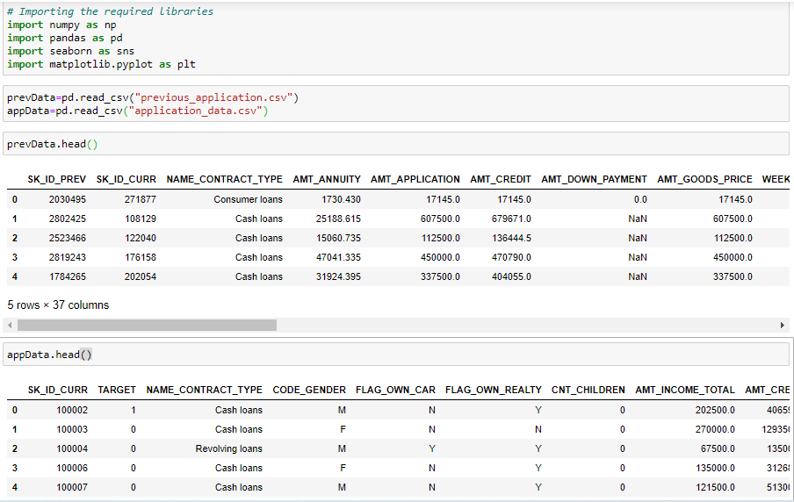
Importing the Data

Slide 6
Cleaning the Data
Columns with more than 30% null values have been identified and dropped from the imported data frames.
Columns that have not been used in the data analysis have been dropped from the data frames.
Columns and rows with maximum null values have been dropped to avoid confusions while plotting the data.

Slide 7
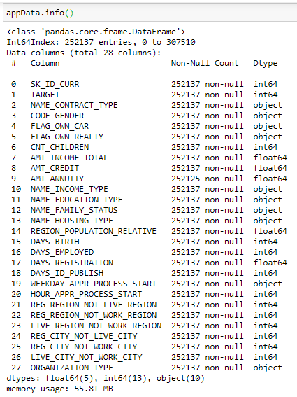
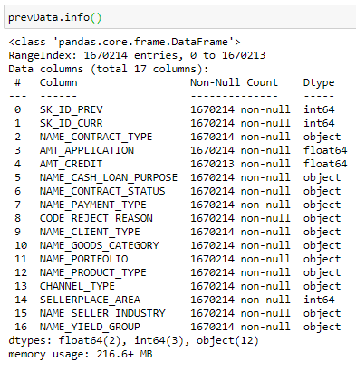
Cleaned Data

Slide 8
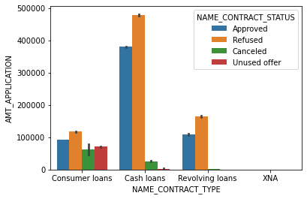
Understanding previous applications data
The graph below depicts a comparison of Contract type and loan application amount grouped by the contract(loan) status.
Based on this graph, the decisions on ‘Consumer loans’ are almost similar irrespective of the loan application amount.
Whereas the Cash loans have a very low instances of being cancelled or unused. Most of the loans are acted upon by the company.

Slide 9
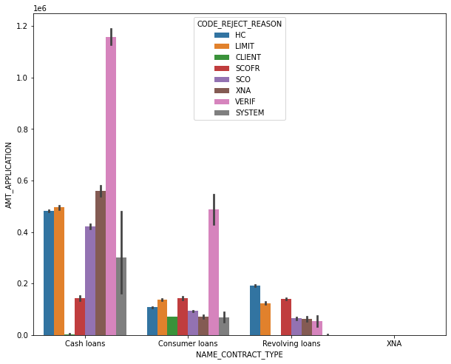
Understanding previous applications data
In both Cash loans and Consumer loans, the most common reason for rejection is Verification issues.
We can infer from this that Verification is the important stage where most rejected applications are found.

Slide 10
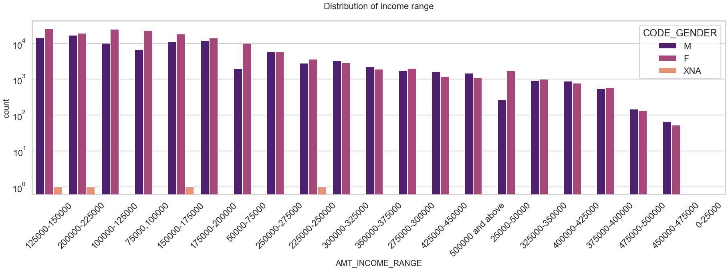
Distribution of Income range
Most customers have an income of 100k-225k.
Very few customers compared to other income brackets have an income greater than 400k.
We can infer from this that people with income in 100k-225k are the most common target customers for the company.

Slide 11
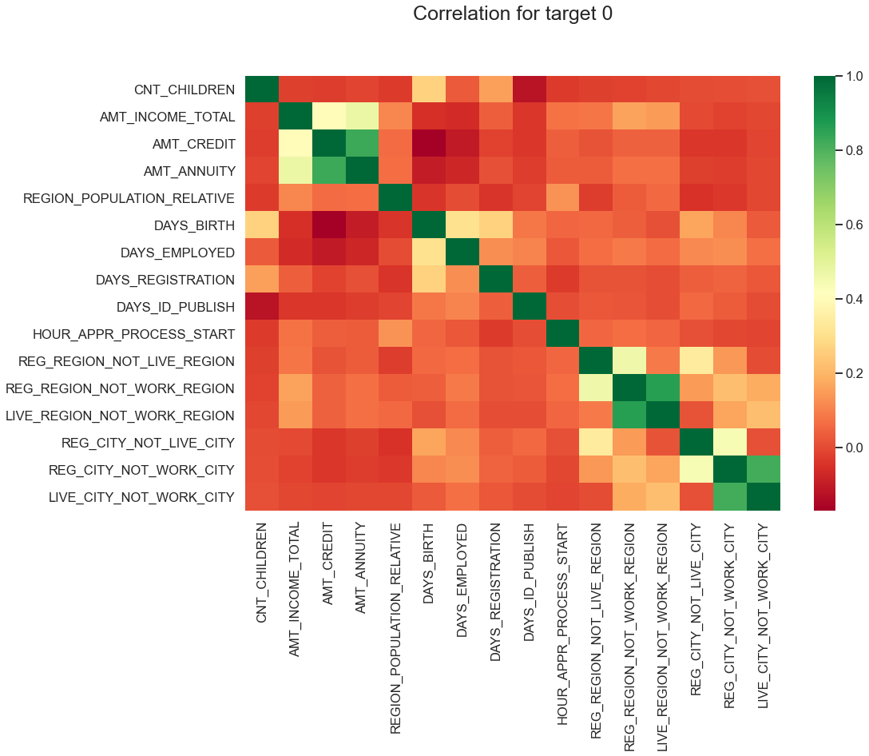
Correlations
Target-0
Target-0 implies that the Customer doesn’t have any difficulties in paying the loan instalments.
There is a very strong correlation ‘Annuity amount and Credit amount’, ‘Credit amount and Income amount’.
There is almost no correlation found between ‘Age and Credit amount’.

Slide 12
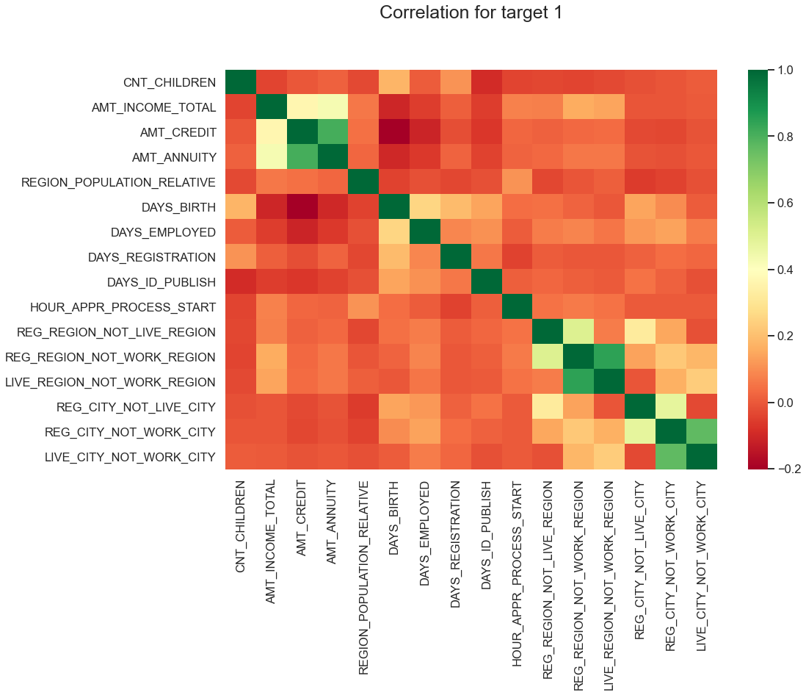
Correlations
Target-1
Target-1 implies that the customer is facing some difficulties in paying the loan instalments.
The correlations found for customers with difficulties is similar to the correlations found with customers that don’t.

Slide 13
Other Analysis done
The relationship between ‘Loan Contract Type’, ‘Application Amount’ and ‘Loan Contract Status’ has been studied to identify what kind of loans have been approved or rejected mostly and for what range of Application amounts.
The relationship between Credit amount and Education Status of the customers has been studied for both target-0 and target-1 customers.
The relationship between Income Amount and Education Status of the customers has been studied for both target-0 and target-1 customers.
The counts of target-0 and target-1 customers has been analysed based on the Cash Loan purpose to identify the most likely and least likely reasons a loan has been approved where the customer has difficulties in repaying the instalments.

Slide 14
Conclusions – Inferences Summary
Cash loans are the targeted loan type to obtain a higher credit amount.
The probability of a loan getting rejected increases as the credit amount for the loan application increases.
Most rejected Cash loans and Consumer loans are rejected due to verification issues. So it may be understood from this information that Cash loans and Consumer loans might be major targets for defaulters or frauds to apply.
Majority of the customers applying for a loan belong to the income bracket of 100k-225k. This can be taken into consideration while contacting customers for a loan application.
Very few customers have an income above 400k, which means people that earn such high salaries often do not opt to take a loan.
The major categories of income types of the customers are 'Working', 'Commercial Associate', 'Pensioner', and 'State Servant'. So people of these categories can be treated as target customers by the company to attract business.

Slide 15
Conclusions – Inferences Summary
The major categories of Industry types where the customers work are: 'Business entity type 3', 'Self Employed', 'Other', 'Medicine', 'Government'. So the target customers can be described as someone from one of these industries.
The major categories of income types of customers that are facing difficulties in paying the loan installments are 'Working', 'Commercial associate', 'State Servant'.
The major categories of Organization types of customers that are facing difficulties in paying the loan installments are 'Business entity type 3', 'Self employed', 'Other', 'Medicine', 'Government'.
Customers that have applied for loans with reason as 'Other', 'Urgent needs', 'Buying a car', or 'Building a house' have been found to have most difficulties in paying the loan installments.
Most Customers that live in an Office apartment or Co-op apartment have difficulties in paying loan installments.
Least number of customers living in a House/apartment or a Municipal apartment have difficulties in paying loan installments.

Slide 16
Conclusions
So the target customers for the company to avoid defaulters can be defined as follows:¶
Loan Type - Cash Loans or Consumer Loans
Credit amount - Upto 200k
Income bracket - 100k-225k
Income type - 'Working', 'Commercial Associate', 'Pensioner', and 'State Servant'
Housing Type - 'House/apartment', 'Municipal apartment'

Slide 17
Thank you!

